Slide 1

MCSD 5-YEAR FORECAST
PRESENTED October 30, 2017 by Randy Bertram, Treasurer
Board Approval November 27, 2017

Slide 2

MCSD 5-YEAR FORECAST
Revenue
  General Property and Public Utility Tax
  Restricted & Unrestricted State Aid
  Property Tax Allocation
  All Other Operating Revenue
  Revenue Overview and Detail
Expenditures
  Personnel Services and Benefits
  Purchased Services
  Supplies, Material & Capital Outlay
  Intergovernmental Debt & Other Objects
  Expenditure Overview and Detail
Forecast Comparison
Rev. vs. Exp. And Cash Balances
Summary

Slide 3
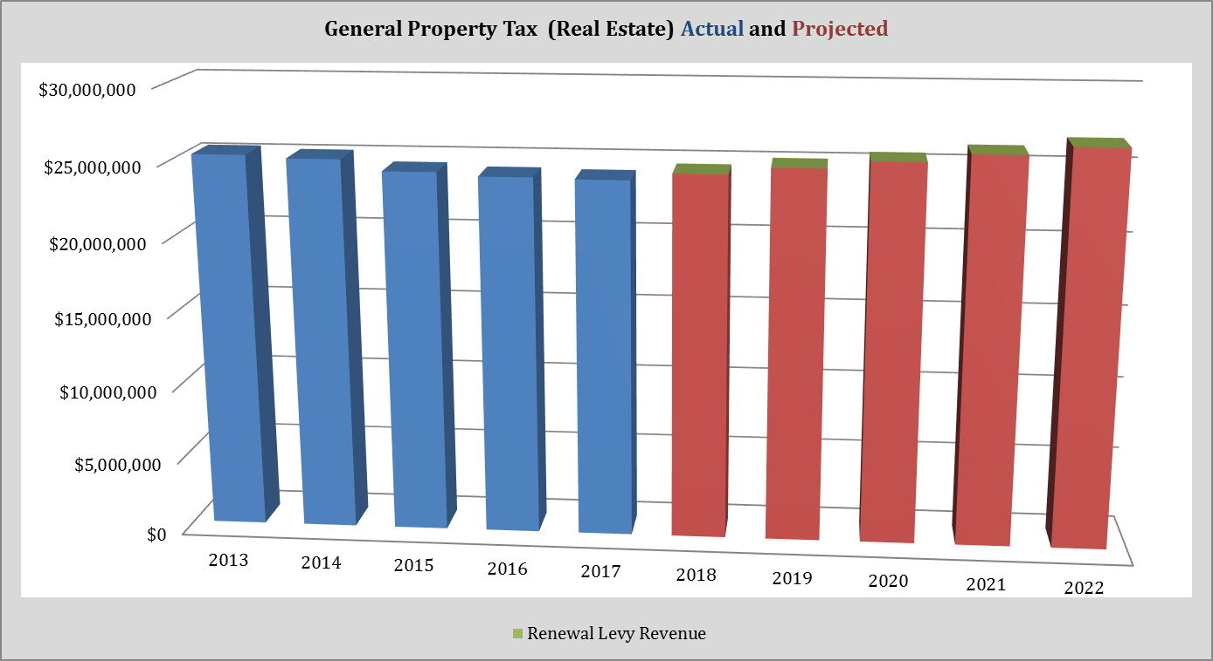
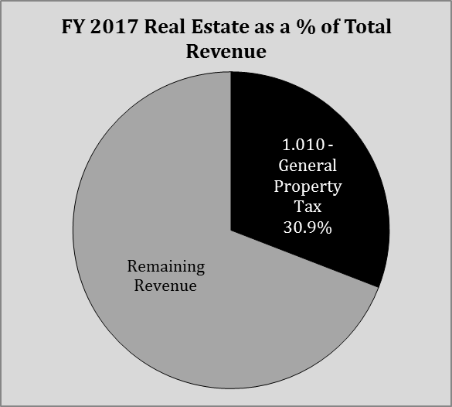
REVENUE
1.010 General Property Tax
Real estate property taxes include homes, farms, businesses, buildings and land. The revenue from this local tax is 30.9% of the district’s budget.
Revenue dropped from 2012 to 2015 because property values decreased $71,000,000 over the three years ending December 31, 2014.
The percentage of current taxes paid by taxpayers dropped from a high of 96.2% in 2012 to 92.6% in 2014, and improved to 93.8% in 2015. With the collection of current and delinquent bills we are collecting at 99.8% of current billings.
This projection includes modest valuation gains of 4.72% through the forecast period.

Slide 4
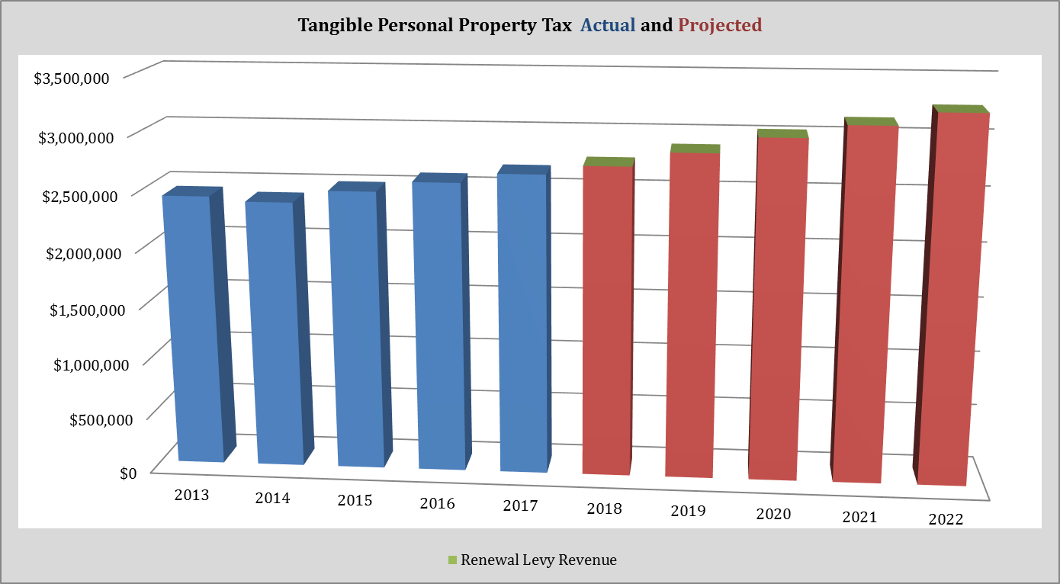
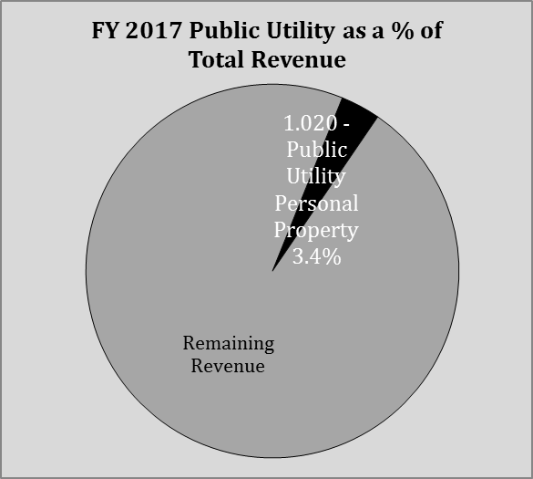
REVENUE
1.020 Public Utility PP Tax
Public Utility Personal Property (PUPP) tax revenue provides 3.4% of the district’s revenue. PUPP values have increased moderately, and consistently, with this trend projected to continue.
The 2014 revenue dipped slightly because of the timing of payments that shifted some 2014 payments into 2015. The projections assume a 50% split of taxes paid in the 1st half versus 2nd half of the collection year.
A natural gas electric generating plant is being constructed within the district’s boundaries. While there will be some local tax revenue growth starting 2019 tax collection year, with some of the public utility personal property of this plant will be tax exempt for 10 years. The district is meeting with plant officials to try to get accurate valuation assessments, we will update the forecast when information is clearer and available to include any additional tax revenue. Any additional tax revenue may also have an adverse effect on our state aid revenue over time.

Slide 5
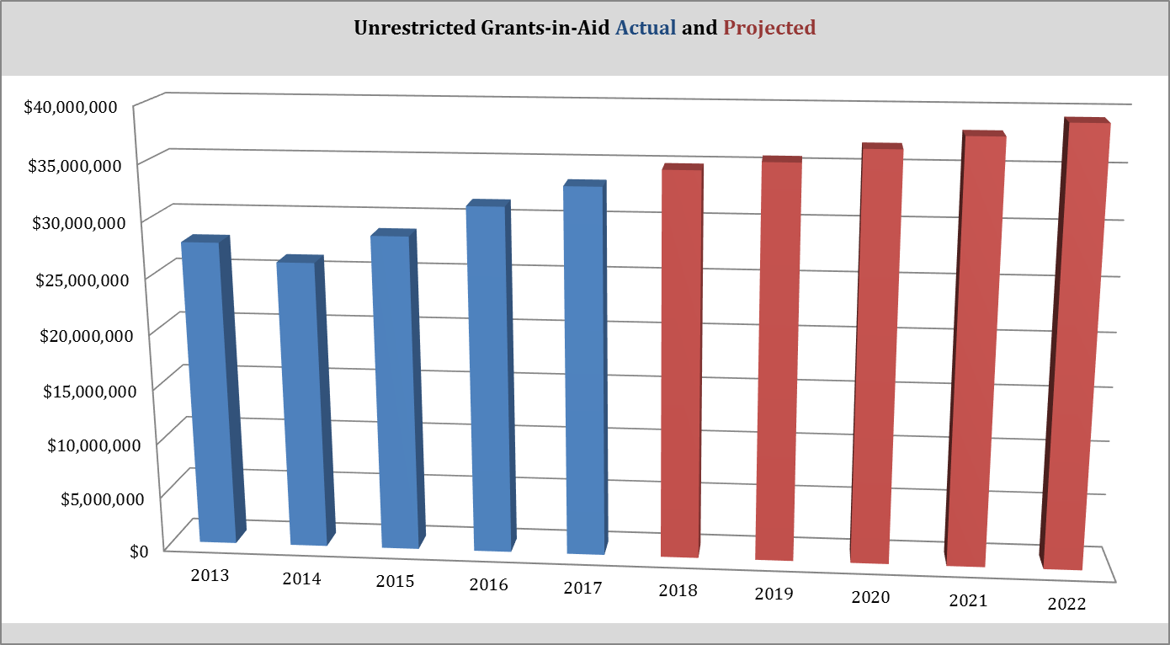
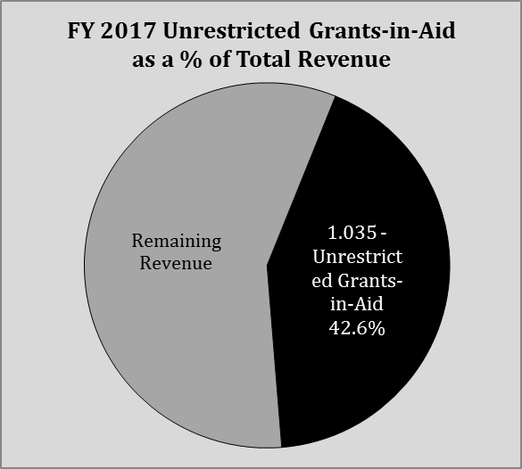
REVENUE
1.035 Unrestricted Aid
Unrestricted state revenue is 42.6%, up from 39.6% a year ago.
The state’s share of the $6,010 ($6,000 FY17) in per pupil funding is 70.64% (67.18% FY17) and generates $4,246 ($4,031 FY17) per pupil. The is relatively high because the district’s 78.76% (76.72% FY17) of the state-wide median, and more importantly, the district’s per pupil valuation of $89,551 ($91,615 FY17) is 61.61% (63.41% FY17) of the state-wide average of $145,363 ($144,466 FY17).
On average, state-wide one mill of local property tax will generate $145 per student which is 63% high than MCSD which is $91.
The district’s year-over-year funding gains were capped by state legislation at 7.5% in fiscal years 2016 and 2017 and are capped at 3.0% for FY18 and FY19. This “CAP” prevents the district from receiving all of its calculated per pupil funding. A 3.0% year-over-year cap from 2020 through 2022 is modeled.
The cap is keeping us “underfunded” by:

Slide 6
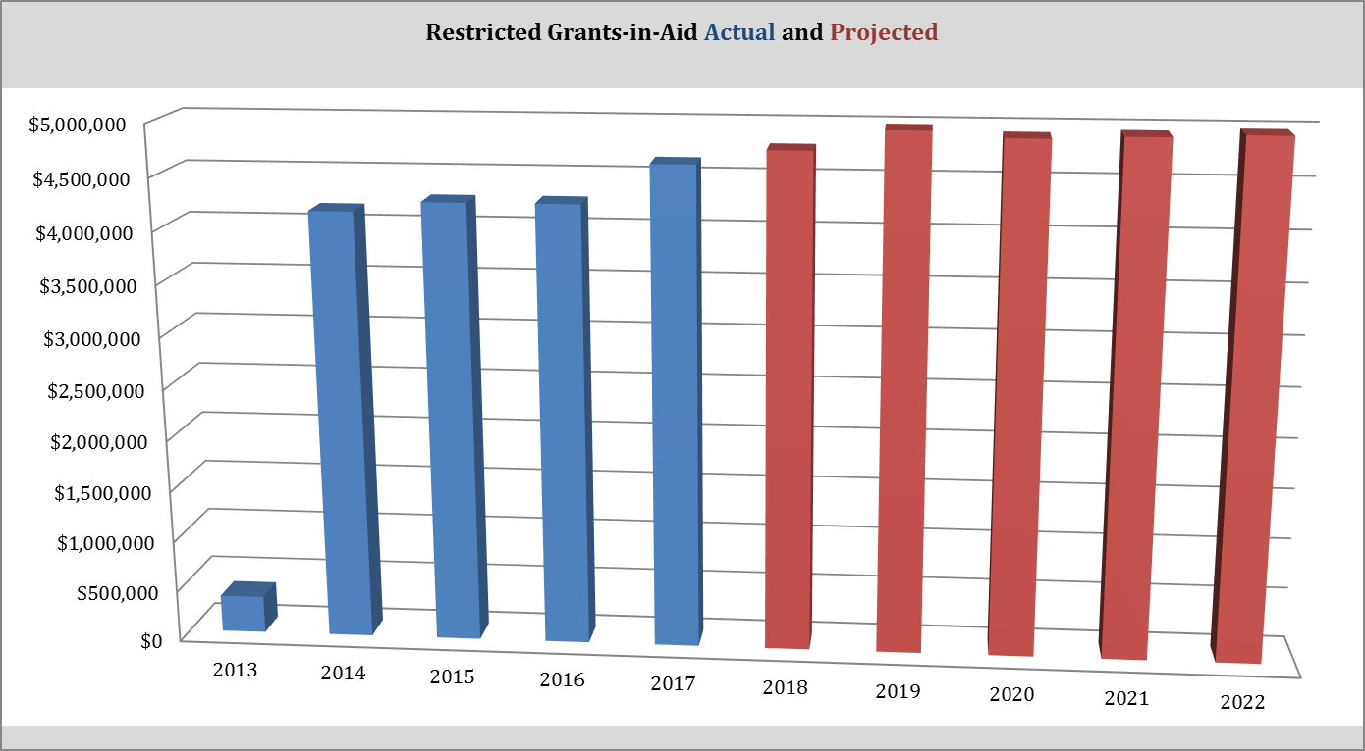
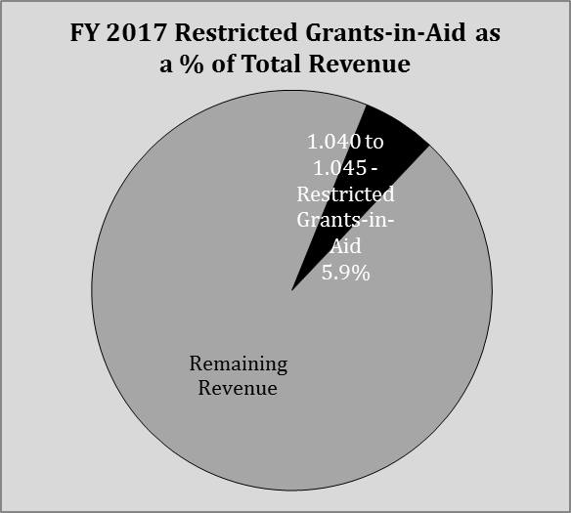
REVENUE
1.040 Restricted Aid
Restricted state funding is primarily comprised of economic disadvantage funding and makes up 5.9% (5.4% FY17) of total district revenue. Starting in 2014 districts were required to post this revenue separately from unrestricted aid, which is why we have a large increase in 2014.
Approximately 90% are identified as economically disadvantaged for state funding purposes; it is this high level of poverty that generates the bulk of this revenue. This level of poverty is estimated to remain constant throughout the forecast.

Slide 7
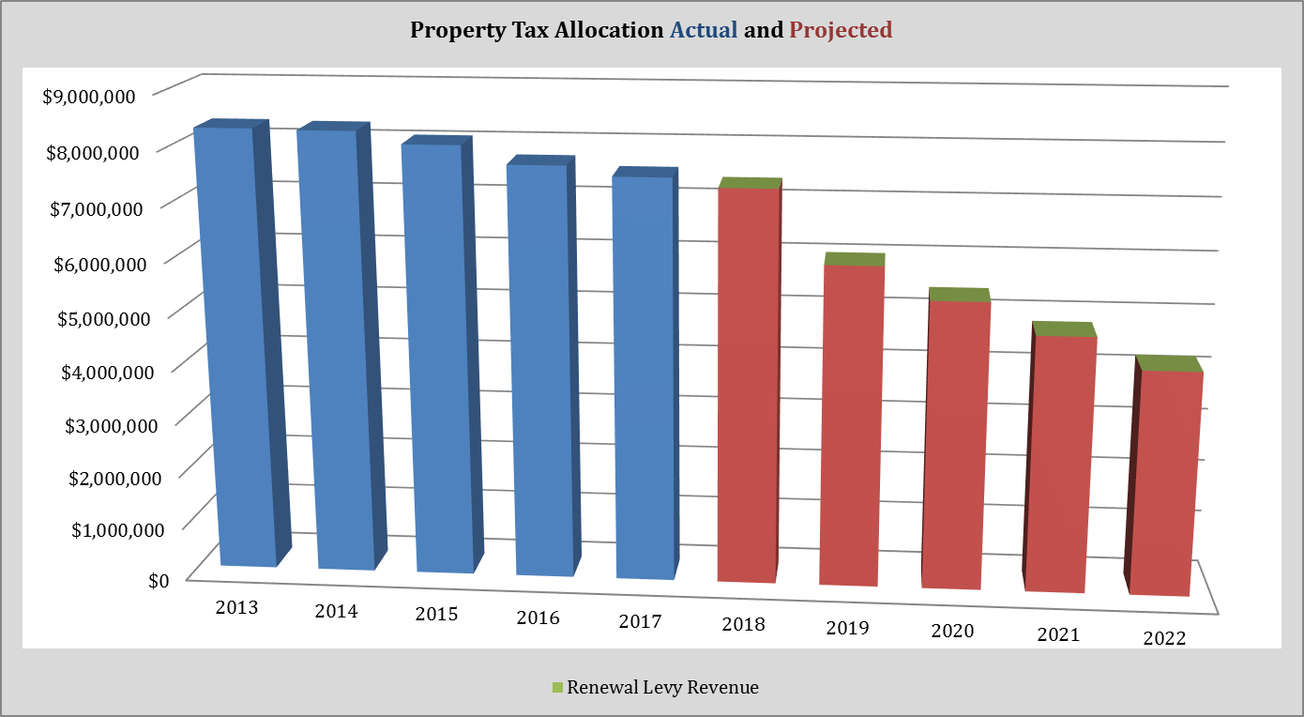
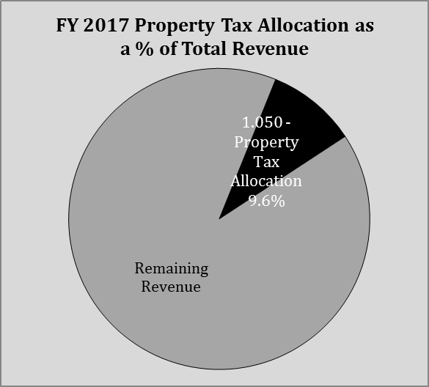
REVENUE
1.050 Property Tax Allocation
Property Tax Allocation (PTA) is comprised of three types of revenue that when combined are currently about 9.6% (9.7% FY17) of district revenues.
Two types of the PTA involve state reimbursements for local real estate tax credits (deductions), rollback credit at 10% for homeowners and an additional 2.5% for owner occupied residence, and a homestead credit for the disabled and senior citizens for an additional 2.5%. This revenue reimbursement is about $3,500,000.
The third type of revenue included in PTA is the state’s reimbursement of local property tax revenue losses resulting from statewide tax policy changes in 2005. This revenue is scheduled to phase-out in 2018, and will result in higher local property tax rates to offset the state’s annual phase-out amount. The state’s reimbursement of $3,400,000 in 2017 to $343,743 in 2022. This phase out will continue until it is completely eliminated with local tax rates adjusted upward.
The district also receives some supplemental state reimbursement from other fixed sum operating levies in this revenue category, the amount is $750,000 in FY18 and is reduced to $0 in FY19.

Slide 8
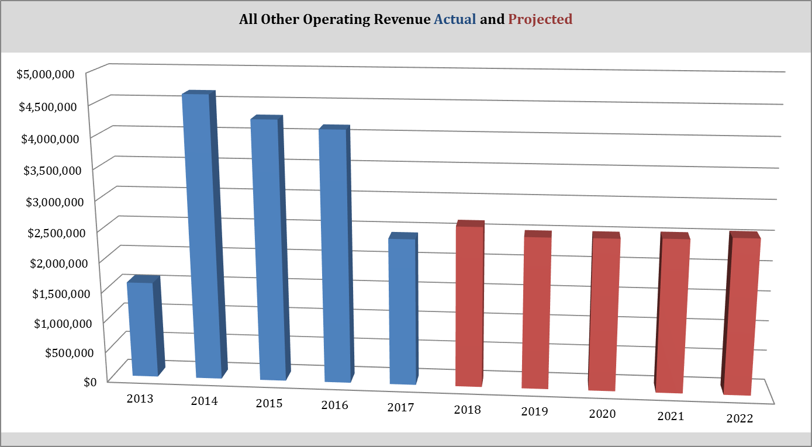
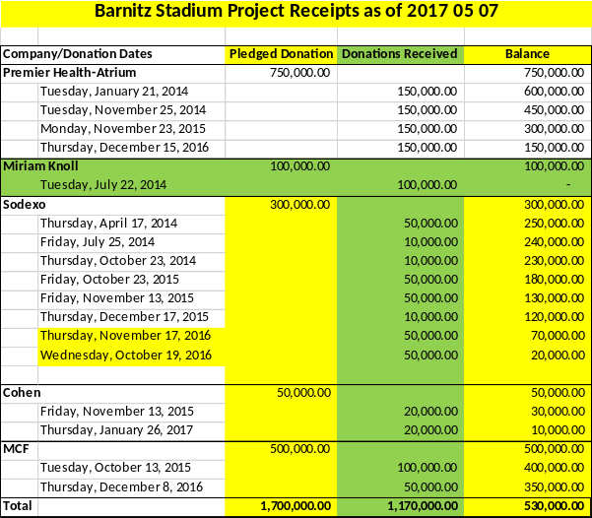
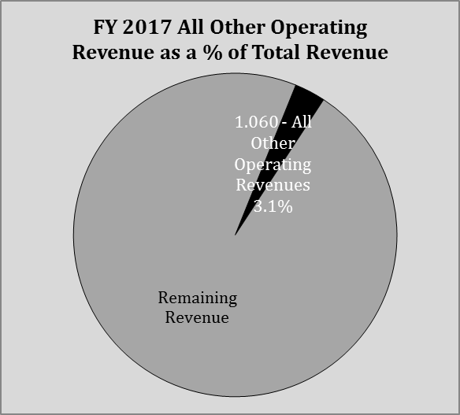
REVENUE
1.060 Other Operating Revenue
Other operating revenue is higher in 2014, 2015 and 2016 because of annual borrowing to finance capital projects. The district borrowed for Barnitz Stadium renovations of $1,587,915, $1,600,000 and only $1,090,000 in these years respectively.
The district received donation commitments for this project and we have received the following:
Other revenue includes tuition paid by other districts ($1,146,944 est. FY18) and payments in lieu of taxes ($550,000). Medicaid payments are estimated at $250,000 annually.

Slide 9
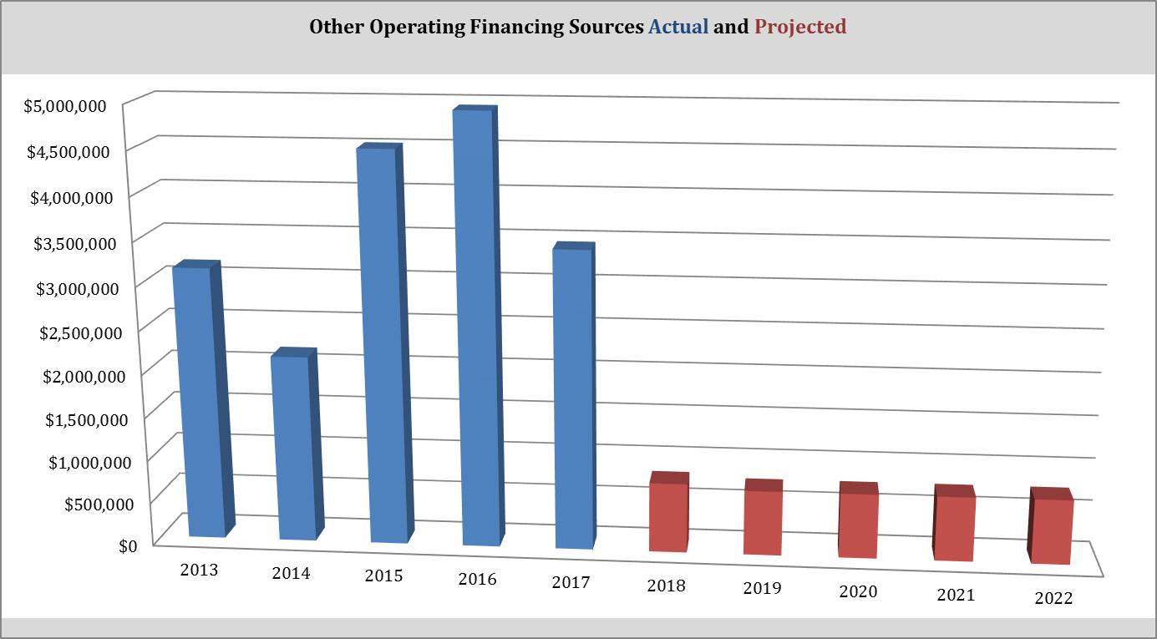
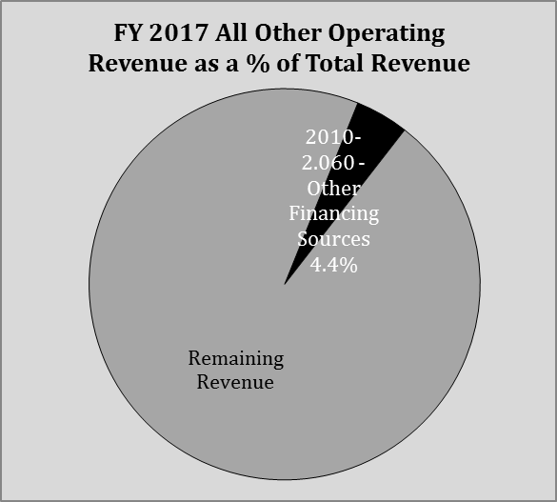
REVENUE
2.070 Total Other Finances
In 2015 and 2016 the primary source of this revenue was for cash flow borrowing. Because of the low cash balance the district had on hand it was necessary to borrow $3,500,000 and $2,500,000 during 2015 and 2016 respectively. This money was paid back in the same year that is borrowed. No cash flow borrowing is anticipated moving forward.
In addition to the 2016 cash flow borrowing the district received an unexpected payment of $1,475,000 for Medicaid reimbursements stemming from 2005 through 2010 qualified expenses. $590,076 of this reimbursement was moved to district escrow account in the event a Federal audit was conducted and some repayment is required.
Advance repayments for grants is estimated at $750,000 annually 2018 through 2021. It was higher in 2017 ($2,310,377) but is not expected moving forward.

Slide 10
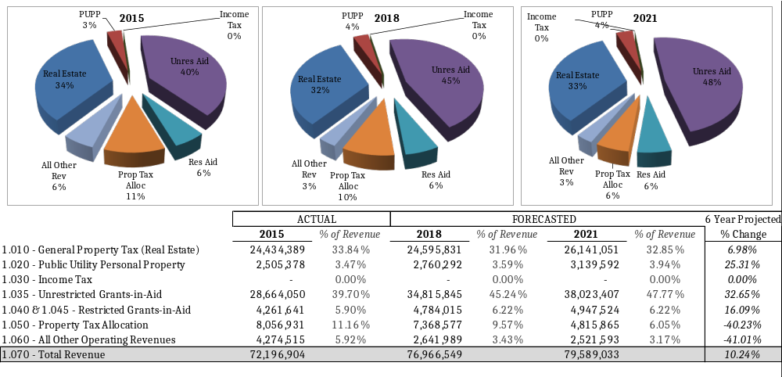
REVENUE OVERVIEW

Slide 11
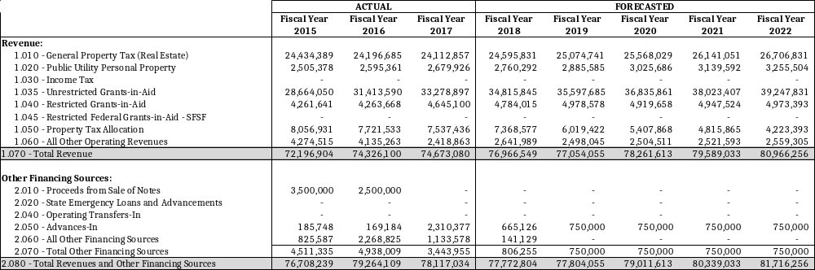
REVENUE DETAIL

Slide 12
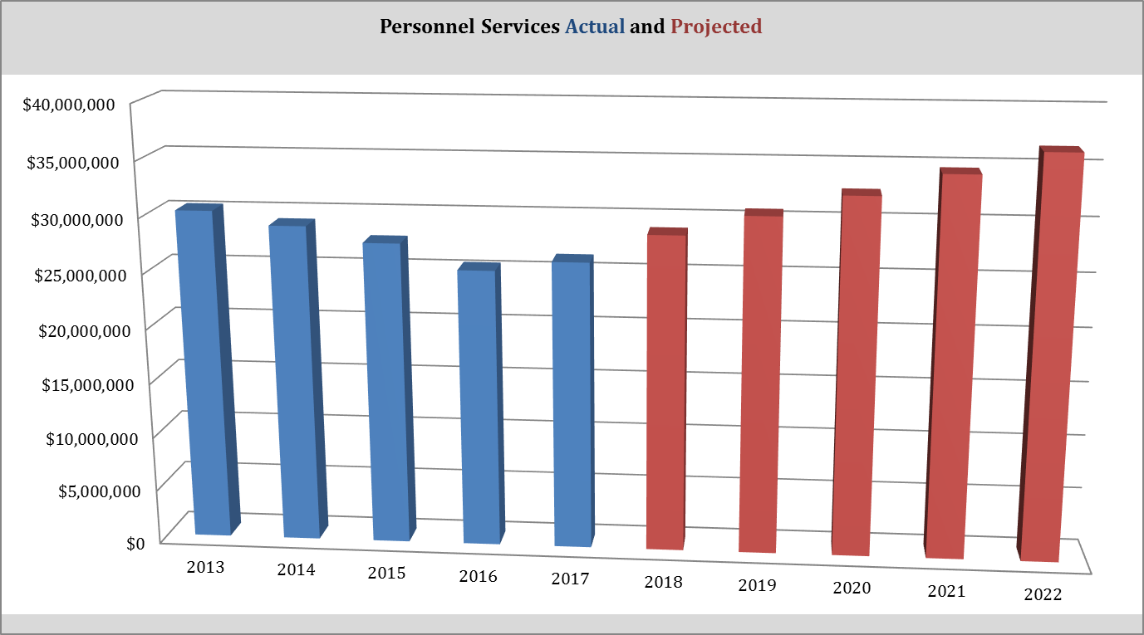
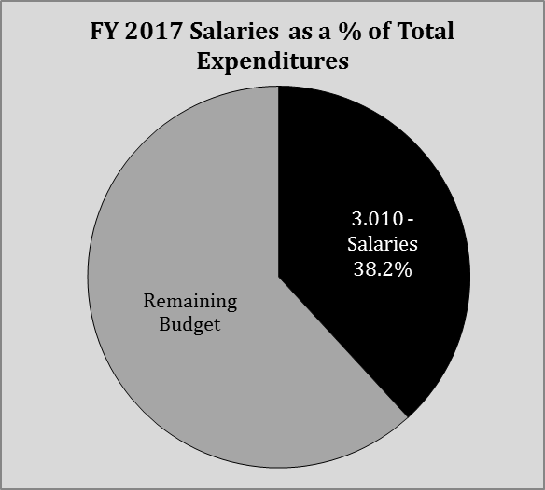
EXPENDITURES
3.010 Personnel Services
Salary costs are 38.2% (34.4% FY17) of the budget in FY18 and are still 1.43M less than FY13. The 2016 salaries ended about $1,200,000 less due to high staff turnover.
The salary reductions in part is because of the substantial retirement-replacement savings. The average teacher salary in 2015 was $55,230 and is 4.57% lower in 2016 of just $52,705.
FY17 and Fy18 salaries included some salary costs shifting to purchased services, but the effect is minimal.
Overall salaries are projected to increase 9.7% in FY18 and 6.8% over the forecast period annually. These increases include the reinstatement of steps in FY17 and annual cost of living increases starting in FY14. Net staffing increases of 14 FTEs are also included in FY18.

Slide 13
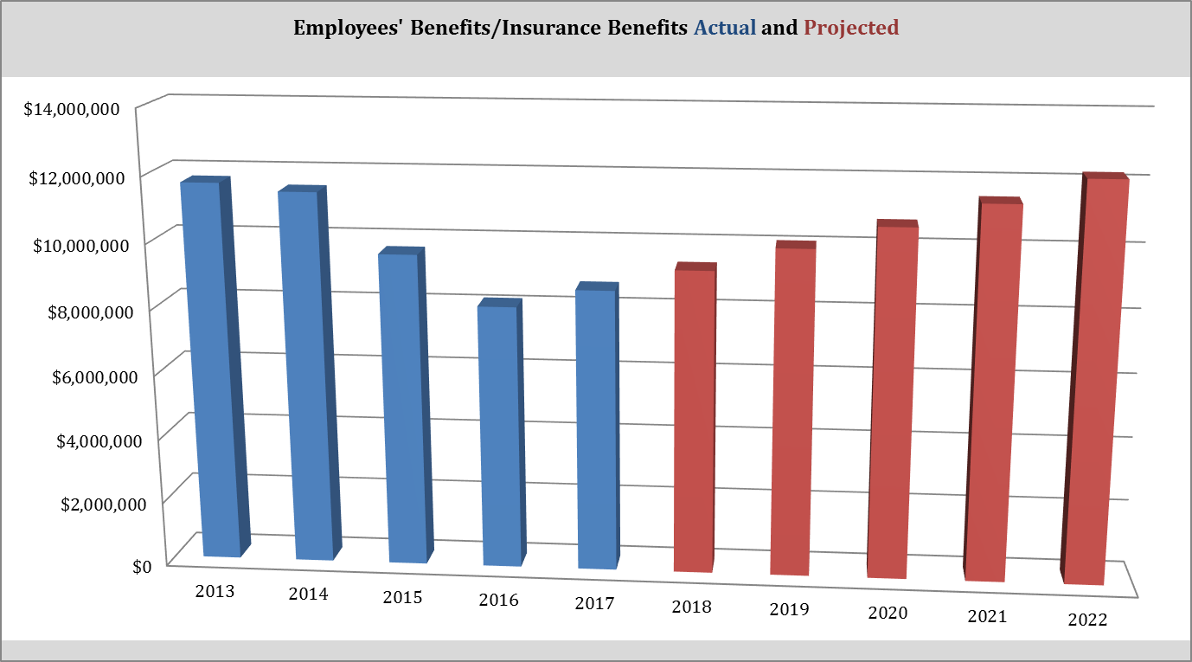
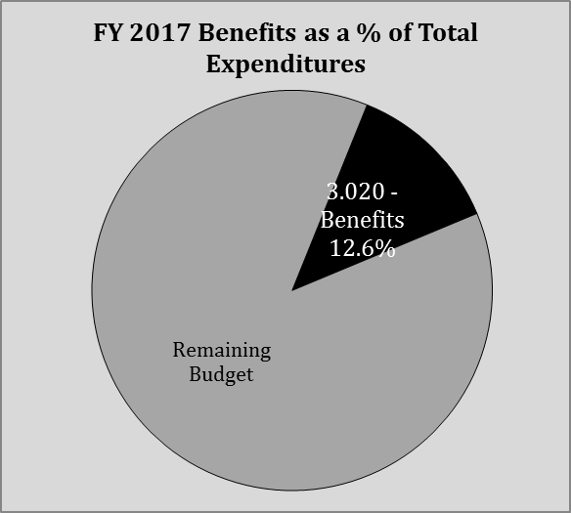
EXPENDITURES
3.020 Employees’ Benefits
At 12.6% of the budget, benefit costs have been significantly contained by salary reductions, which in turn reduces benefit contributions, and by health insurance cost controls.
Medical insurance costs have been controlled by proper plan administration and a healthier and younger work force. Health insurance has not increased since 2014, and we actually saw a reduction of 4.95% in 2016, and will not increase for calendar 2017. We will realize a 6.0% increase January 1, 2018. We have modeled 8% increases through 2022.
Benefits costs also include Workers Compensation, STRS, SERS, Medicare, Unemployment and other fringe benefits.

Slide 14
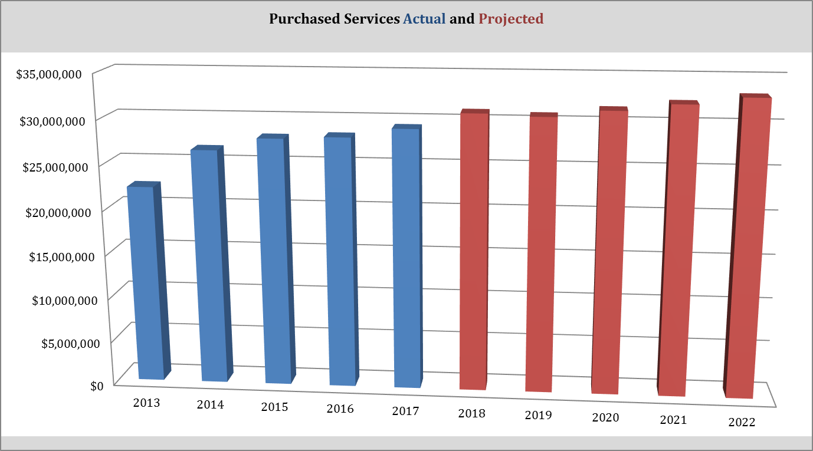
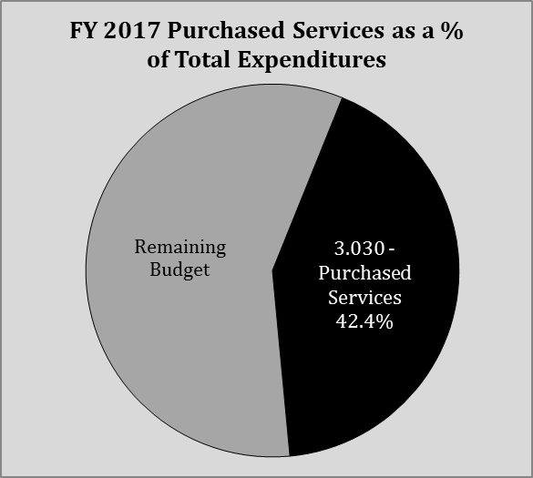
EXPENDITURES
3.030 Purchased Services
Purchased services are 42.4% of the budget and up from last year’s 38.2% of budget. Costs have increased since 2011 because of the outsourcing of non-instructional services, but also because of the increase in community school, open enrollments and scholarship (vouchers) tuition payments.
Total tuition payments including scholarships, open enrollments, PSEO/CCP payments, make up 50% of purchased services. Community school tuition payments were the single largest in 2017 at $7,400,000, up $2,300,000 from 2011.
Tuition payments are expected to grow by 5% annually. This is a tough area to project costs because of the special education component and volatility associated with community school enrollments.
The second largest category of purchased services involve outsourcing transportations, custodial, maintenance and other professional services. Preschool services has been expanded in FY12 for a $600,000 estimate.
Utility costs make up about $1,400,000 of this line item.

Slide 15
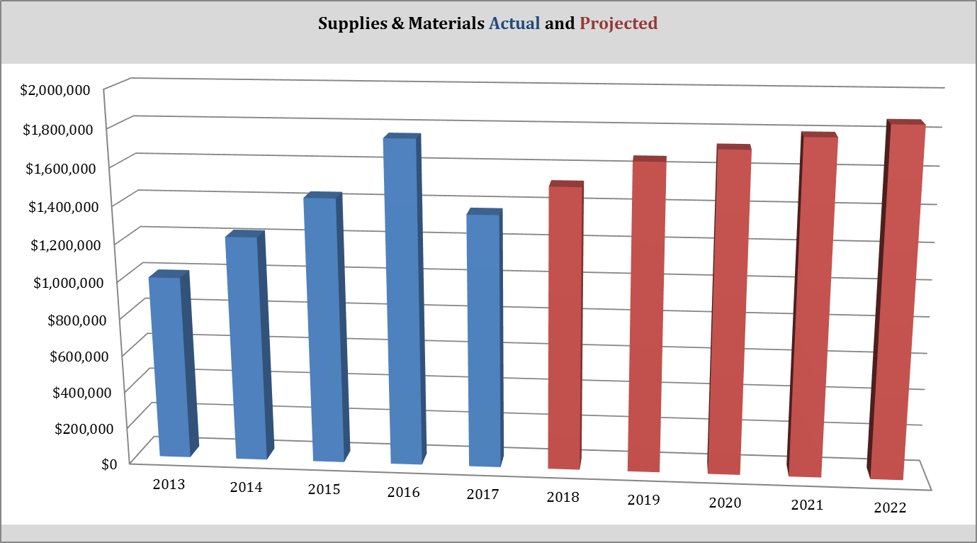
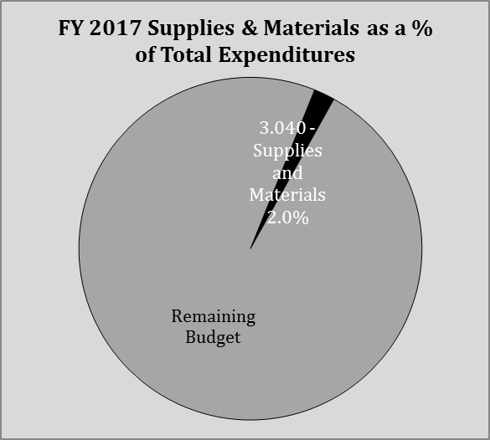
EXPENDITURES
3.040 Supplies and Materials
Supplies and materials are just 2.0% of the budget in 2017 which is a decrease from the 2016 level of 2.4%.
Of the $1,365,643 spent in 2017, $657,833 was used for instructional supplies, $295,466 for textbooks and $412,344 was used for transportation and other supplies.
The district committed to textbook adoptions in FY16 which was $722,239 and $295,466 in FY17. Textbooks annually are budgeted at $400,000 moving forward. It had been seven years since the last textbooks were purchased.
The district is committed to $1,500,000 annually for needed supplies and materials with annual growth of about 5%.

Slide 16
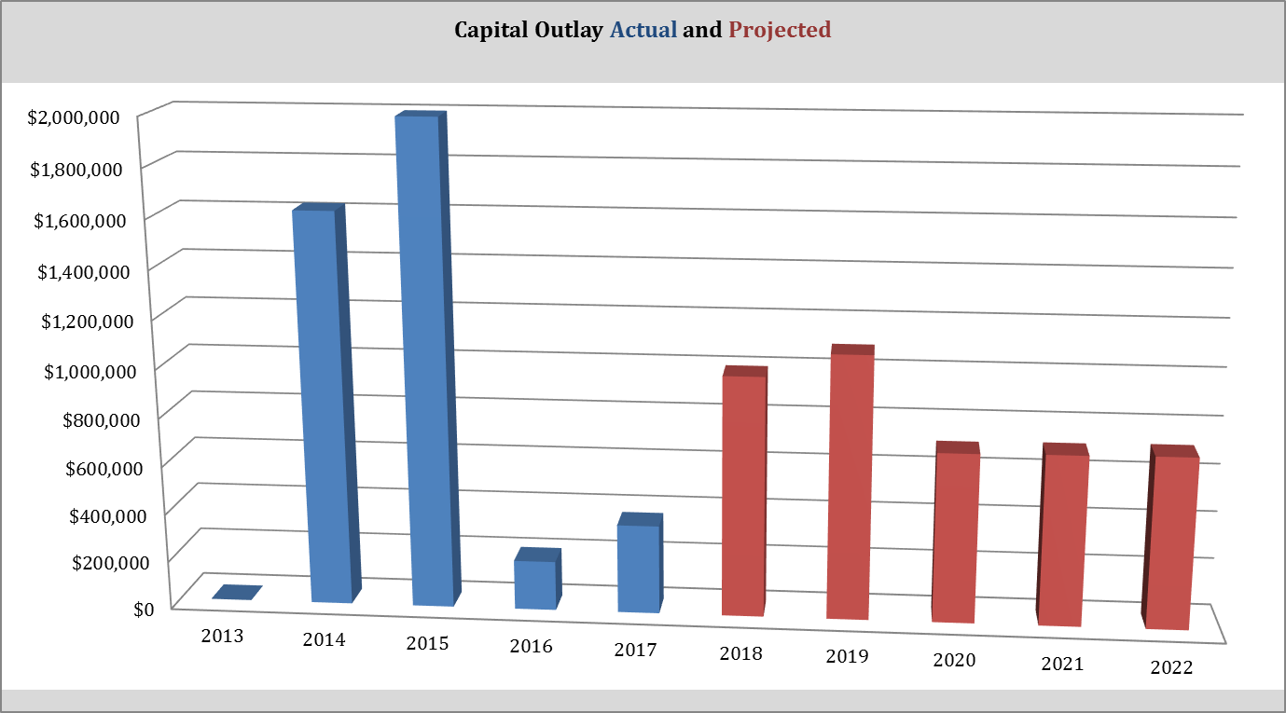
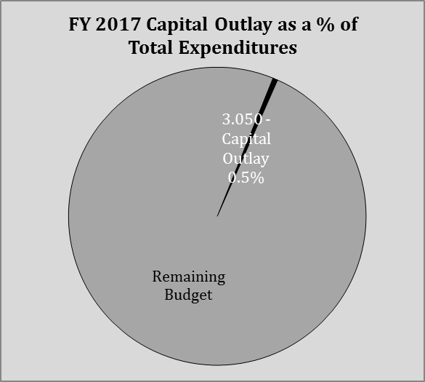
EXPENDITURES
3.050 Capital Outlay
Although the district committed little to no monies in capital outlay in FY12 and FY13, the district spent considerable dollars in 2014 and 2015. In FY16 and FY17 little was spent because we were able to commit a large amount of Federal Title I carryover funds to technology purchases.
The district is committing resources to capital expenditures moving forward. $430,000 is budgeted in FY18 for the Student & Family Health Center and for a van to transport students using this Health Center. In FY19 $400,000 is budgeted for the building connector between MMS and MHS and $150,000 for the new HS track.
Capital outlay is modeled at $700,000 in FY19 with 2% inflationary growth annually thereafter.

Slide 17
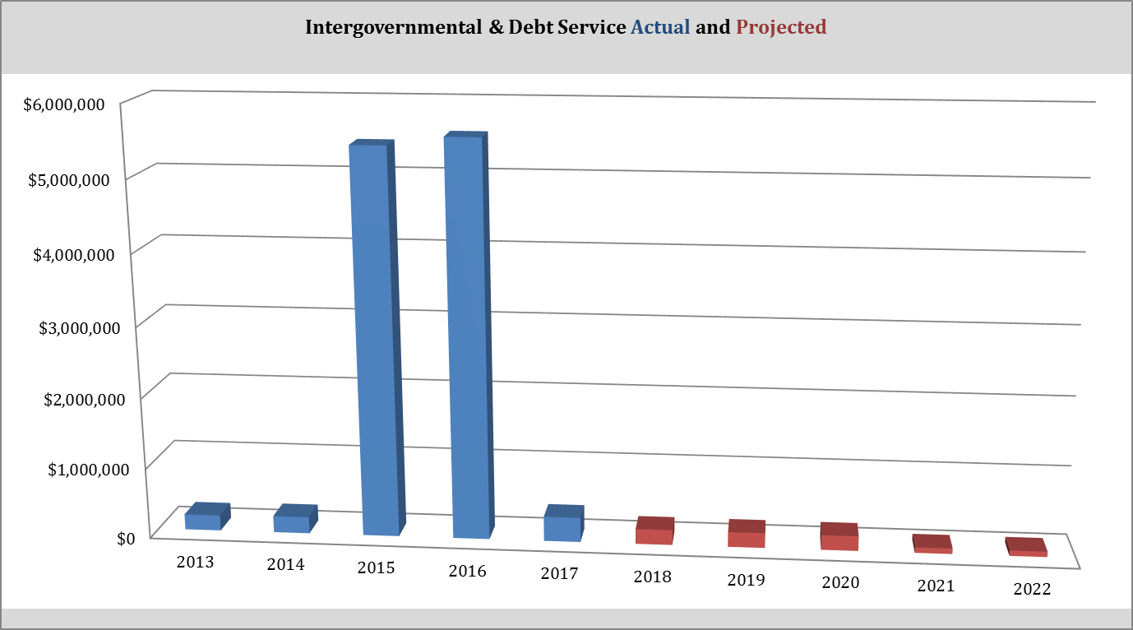
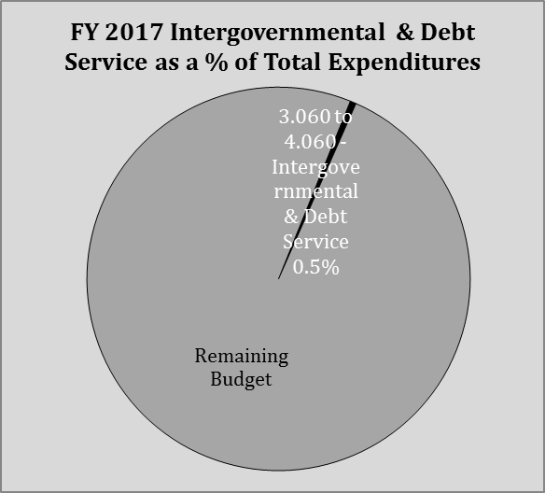
EXPENDITURES
3.060-4.060 Intergovernmental & Debt
One of the district’s three HB 264 Energy Loans was retired a year early in FY17. Of the two remaining HB264 loans remaining one will be paid of by FY20 and the final one by FY29.
The payments in 2015 and 2016 reflect the cash flow borrowing of $3,500,000 and 2,500,000 respectively and Barnitz Stadium improvement loans.
No cash flow borrowing or Barnitz Stadium improvement loans are forecasted.

Slide 18
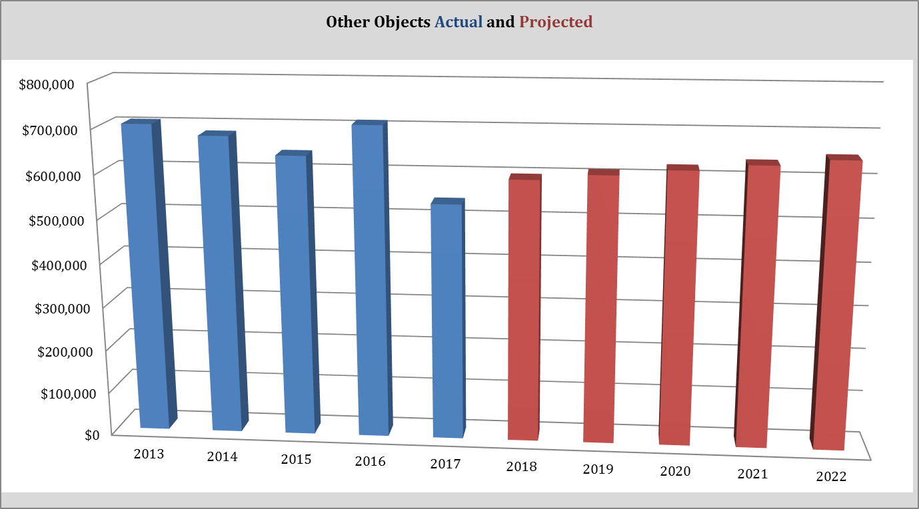
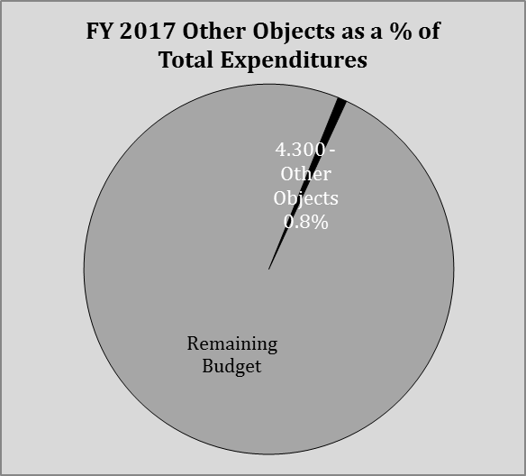
EXPENDITURES
4.30 Other Objects
Other operating expenses include auditor and treasurer tax collection fees, building insurances and other smaller operating costs.
FY17 shows lower fees for local tax collections. This is being reviewed in more detail to determine if this is correct and can be expected moving forward.
The projects reflect a modest annual inflationary increase.

Slide 19
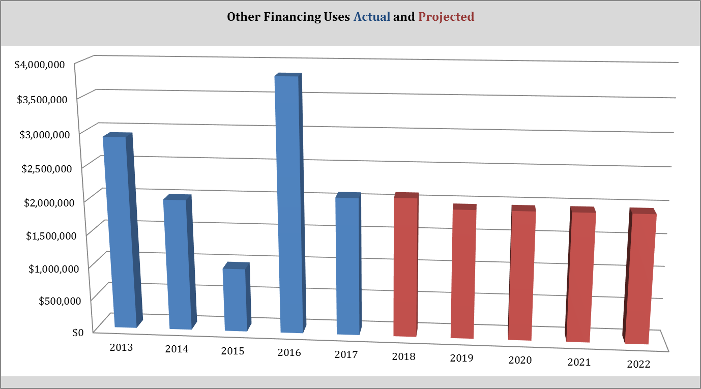
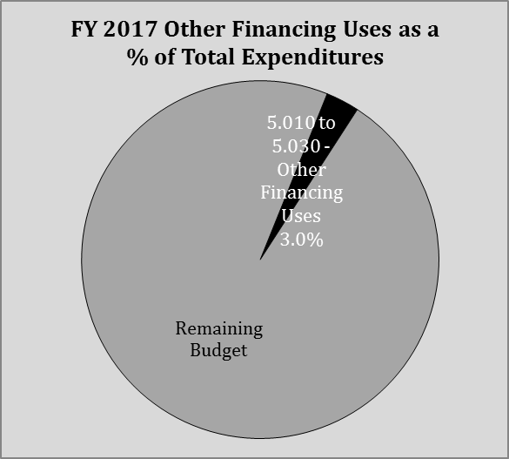
EXPENDITURES
5.040 Total Other Financing
In 2016 the district advanced at year-end $2,310,377 to other funds that returned the advance to the general fund in 2017.
In 2017 and beyond the district is forecasting a $700,000 transfer to cover student waived fees and supplemental staff payments, and $50,000 to the athletic fund.
The district also is moving $500,000 annually which started in FY17 to the PI fund to cover annual maintenance needs throughout the district for building and grounds.
The district is also projecting annual advances of $750,000 to other funds all to be repaid the next year (month).

Slide 20
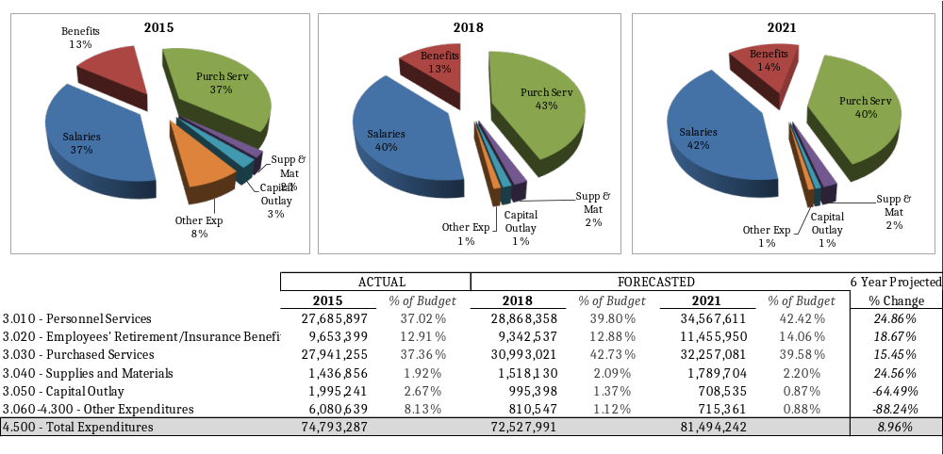
EXPENDITURES OVERVIEW

Slide 21
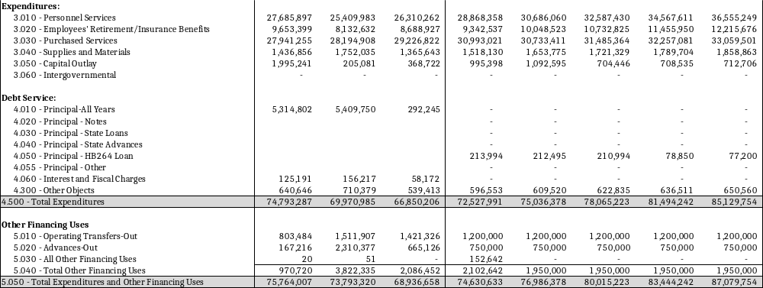
EXPENDITURE DETAIL

Slide 22
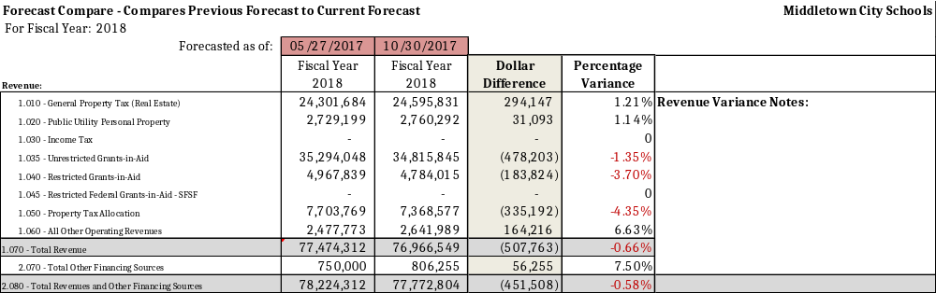

FORECAST COMPARISON - REVENUE

Slide 23
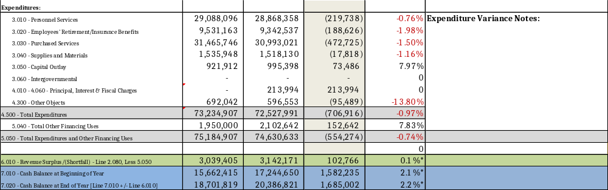
FORECAST COMPARISON – EXPENDITURES

Slide 24

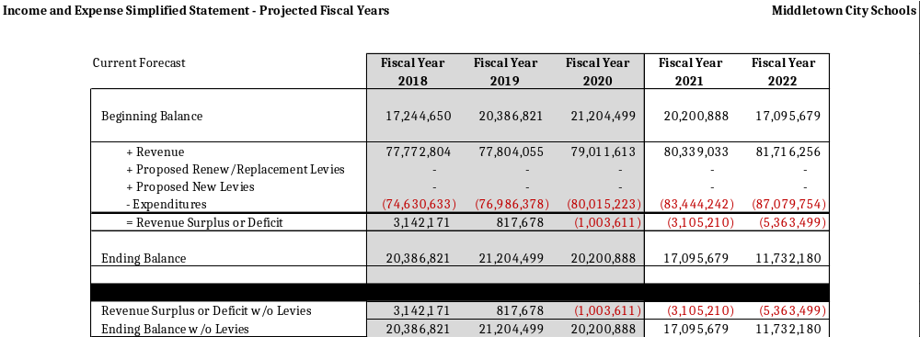




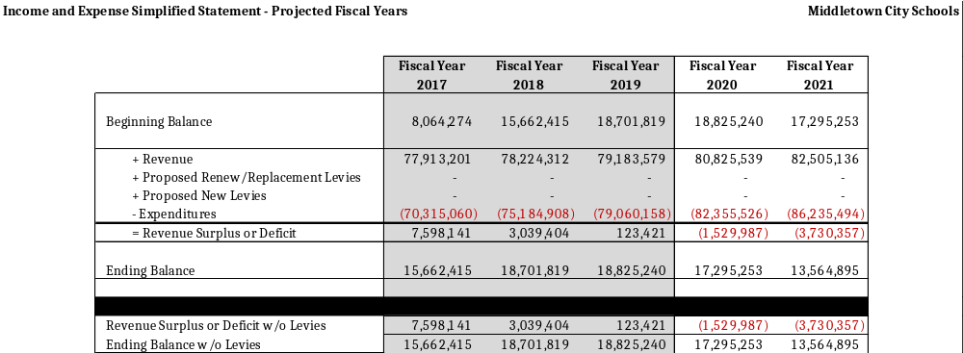



FORECAST SUMMARY
Previous Forecast

Slide 25
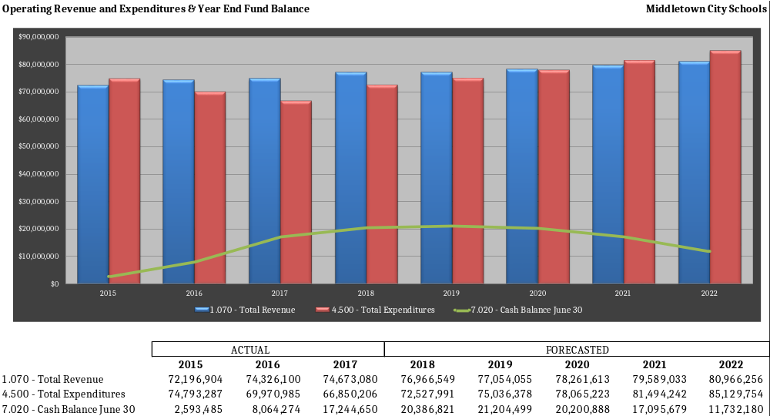
Rev vs. Exp – Year End Fund Balance

Slide 26
FORECAST SUMMARY
The district has made considerable effort to reduce and contain costs in order to maintain financial stability. In addition the State of Ohio has increased the district’s per pupil funding. The current forecast shows revenue surplus initially and trends towards revenue shortfall (deficit spending) by 2020. Each year the district will make decisions to impact its actual spending considering its future financial sustainability.
The current forecast largest variance from the prior forecast is line 1.035 and 1.04 State Foundation Unrestricted and Restricted revenue. We estimated a 5.5% increase in the prior forecast and state’s final adopted budget allows for only 3% annual growth in state funding. The district will be receiving about $14,000,000 less than the formula calculation in FY18 and this number is estimated to grow each year with the same 3% estimated annual growth.
The district’s cash balance is expected to be higher than the previous forecast by $1,579,661 June 30, 2018. This is because of a higher than expected ending cash balance on June 30, 2017 of $1,582,235. The FY17 cash balance improved do to an increase in other financing sources of $474,898, salaries came in lower by $350,812, purchase services down by $524,631 and capital outlay was underestimated by $570,502.
The district expects a new power plant to be operational by 2018 which should generate additional tax revenue no later than 2019. We are meeting with the company’s officials and county auditor to determine the effects of increased local property taxes. It is currently expected that this revenue will improve local tax collections in the short run, but in the long run this could have a negative effect and reduce state funding per pupil once the plant’s valuations are included in the state funding calculations. In addition, the taxes for this power plant are currently abated by 75% for ten years.
There are no levies or renewals reflected in this forecast.

